Slide 1
C-LEARN CEP Coalition Workgroup
Session 2 | July 25th

Slide 2
Today’s Agenda
Introductions – 10 minutes
Review of Session 1 – 5 minutes
Activity 1: Challenges and Toolkits – 30 minutes
Break!
Activity 2: Social Ecological Model – 30 minutes
Evaluations and Nominations – 10 minutes

Slide 3
INTRODUCTIONS
10 minutes
Please state your name, the organization you are with, and one thing you want to mention about Tropical Storm/Hurricane Barry.

Slide 4
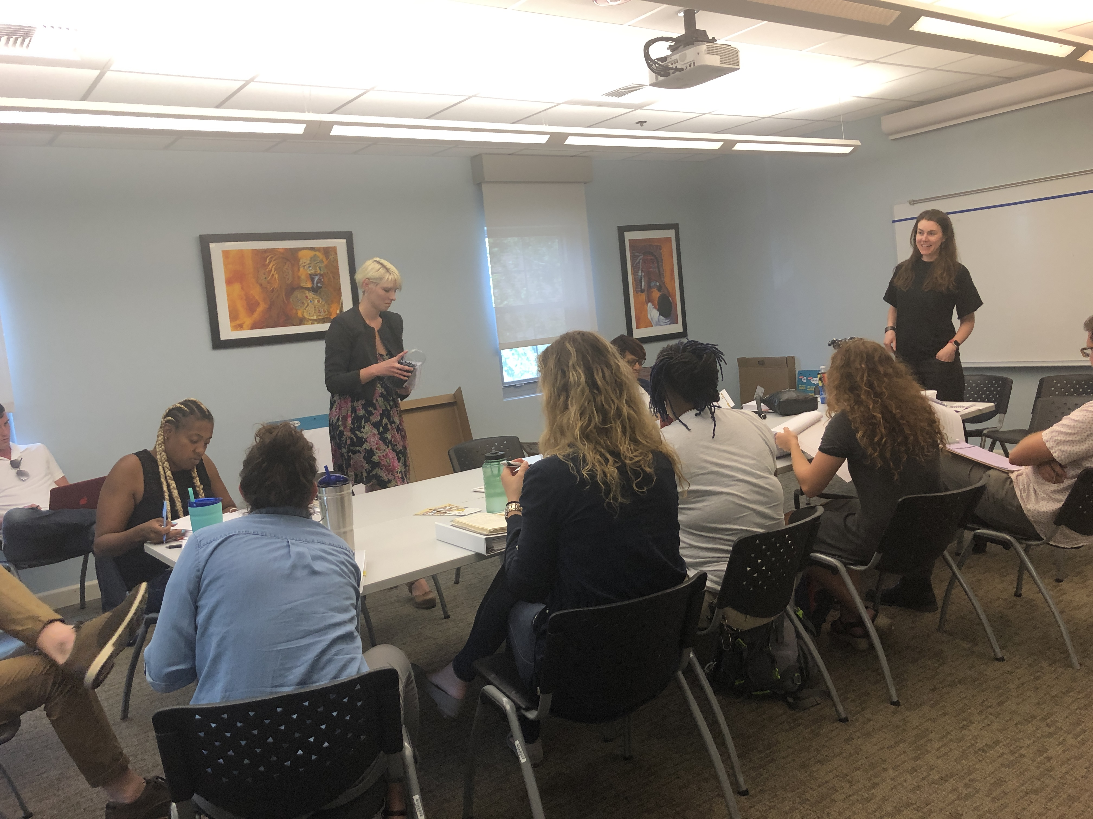
Session 1
5 minutes
The purpose of the last session is to draw on the strengths of the agencies in this group to ultimately add to the idea that coalition building is more effective than working in isolation.

Slide 5
OUTCOMES
Small Group Discussion: We discussed the services, programs, skills and assets of your agencies
Large Group Discussion: Shared out from smaller group discussions to compile a list of services, skills, and existing coalitions.
Additionally, we began brainstorming ways to best use some of the assets we’ve identified.

Slide 6
Services Offered:
case management, job training, policy, advocacy, mentoring, HiSET, 1st time home buyers, restore store, volunteer management, admin, volunteer services, home repair, closet for women, disaster response/mgmt., community organizing, social justice organizing around minorities, women, front-line work, peer support for formerly incarcerated people, behavioral and primary health at low-cost, Medicaid application, care management, GYN services, ambulatory clinic, advocacy for disabled people, class action lawsuits, family visits for incarcerated people, money on the books for food and supplies for incarcerated people

Slide 7
grant writers, volunteer mgmt. and admin, social workers, post-disaster services like dispatching volunteers, construction, tools, harm reduction, ending the HIV epidemic, HiSET, voter registration, community engagement, raising voices around health insurance, professional development and training for CHWs, conference attendance, LGBT sensitivity, medical clowning, abortion services, lead removal from water, industrial canal advocacy, podcast – family meal podcast, radio stations – WHIV and other from Ms. Jo
Skills and Assets:

Slide 8
NOLA Equal Justice Coalition and Task Force, Louisiana Correctional Institution for Women, Foundation for Louisiana, Greater NOLA Housing Alliance, Safety and Justice Challenge, City of NOLA (around storm water mgmt), National Association of Community Health Workers, Justice and Beyond, Refresh, Spanish-speaking Resource Coalition, Healthy Communities, Power Coalition, VOTE, LSUMC, Ochsner, 504 HealthNet, CrescentCare, SAGE
Coalitions

Slide 9
CHALLENGES & TOOLKITS
Notes:
If there aren’t many attendee, we will go over them together.
Four groups (one for each SDOH) each will discuss challenges in NOLA related to financial planning, housing, mental health, and disaster preparedness/recovery then go over the toolkits for their topic and discuss:
if they would be of use to their clients or staff,
how can they be improved,
If there are toolkits/resources they’ve heard of or use that we should know about

Slide 10
Topic Areas Group 1: Disaster Preparedness Group 2: Housing Group 3: Financial Planning Group 4: Mental Health
20 minutes to discuss
10 minutes to share
In your groups, discuss the challenges in New Orleans related to your assigned topic area.
Look through the toolkits (in your manual) and discuss the following questions:
Do these toolkits address any of the challenges you discussed?
Would these toolkits be of use to your clients and/or staff?
How could the toolkits be improved?
Are there any toolkits in the topic area that you use in your work?
Pick one person in you group to share out.

Slide 11
BREAK TIME!
5 minutes

Slide 12
SOCIAL ECOLOGICAL MODEL
Notes:
If there aren’t many attendee, we will go over them together.
Four groups (one for each SDOH) each will discuss challenges in NOLA related to financial planning, housing, mental health, and disaster preparedness/recovery then go over the toolkits for their topic and discuss:
if they would be of use to their clients or staff,
how can they be improved,
If there are toolkits/resources they’ve heard of or use that we should know about

Slide 13
The Social Ecological Model
A framework that considers the complex interaction between an individual, relationships, community, and societal factors.
It allows us to understand the range of factors that put people at risk for various health related issues, especially social determinants of health.
The overlapping rings in the model illustrate how factors at one level influence factors at another level.
Suggests that prevention and change is necessary across multiple levels of the model at the same time.
This approach is more likely to sustain prevention efforts over time than any single intervention.
Societal/Political/ Environmental (national, state, local laws)
Community
(relationships between organizations)
Interpersonal
(families, friends, social networks)
Individual (knowledge, attitudes, behaviors)
Organizational
(organizations and social institutions)

Slide 14
20 minutes to discuss
10 minutes to share
In your groups, discuss and identify root causes and potential solutions within each level of the Social Ecological Model for your assigned topic area.
We will refer back to this in the next meeting for a SWOT analysis
Topic Areas Group 1: Disaster Preparedness Group 2: Housing Group 3: Financial Planning Group 4: Mental Health

Slide 15
EVALUATIONS & NOMINATIONS
10 minutes
Notes:
If there aren’t many attendee, we will go over them together.
Four groups (one for each SDOH) each will discuss challenges in NOLA related to financial planning, housing, mental health, and disaster preparedness/recovery then go over the toolkits for their topic and discuss:
if they would be of use to their clients or staff,
how can they be improved,
If there are toolkits/resources they’ve heard of or use that we should know about

Slide 16
Thank you for joining us today!
Our next CEP meeting will be Thursday, August 8th at the AmeriHealth Caritas Community Wellness Center from 2:30 – 4:00.

