Slide 1






Financial Resilience
Session 3: Finance Planning

Slide 2

The Bureau of Consumer Financial Protection (Bureau) created the Your Money, Your Goals toolkit for public use, as well as the training materials presented today. These materials are being presented to you by a representative of the Community Resilience Learning Collaborative and Research Network (C-LEARN) study.
The C-LEARN representative presenting these materials is not an agent or an employee of the Bureau.

Slide 3

Your Money, Your Goals
5
Getting Through the Month

Slide 4



Considers cash only, which includes:
- Public Assistance (SNAP,
WIC)
- Housing Vouchers
- Debit Card Access
Working with a Cash Flow Budget
How much cash do you need to make it through the month?

Slide 5
Savings: Planning for the Unexpected
Beginning balance for the week is the ending balance of the previous week.
To get a starting balance, total your cash, debit card , and account balances.
Source minus use calculation
Ending balance is next week’s beginning balance
 | Week 1 | Week 2
Beginning balance for the week | $37.00 | $122.37
Sources of cash and other financial resources
Income from job | $305.34 | $290.80
SNAP | $280.00
Public housing voucher | $650.00
Total sources of cash and other financial resources | $1,272.34 | $413.17
Uses of cash and other financial resources
Savings | $20.00 | $20.00
Housing | $650.00
Utilities | $59.97 | $95.50
Groceries | $180.00 | $80.00
Eating out (meals and beverages)
Transportation | $240.00 | $60.00
Total uses of cash and other financial resources | $1,149.97 | $255.50
Ending balance for the week | $122.37 | $157.67

Slide 6
Savings: Planning for the Unexpected
Beginning balance for the week is the ending balance of the previous week.
To get a starting balance, total your cash, debit card , and account balances.
Source minus use calculation
Ending balance is next week’s beginning balance
 | Week 1 | Week 2
Beginning balance for the week | $37.00 | $122.37
Sources of cash and other financial resources
Income from job | $305.34 | $290.80
SNAP | $280.00
Public housing voucher | $650.00
Total sources of cash and other financial resources | $1,272.34 | $413.17
Uses of cash and other financial resources
Savings | $20.00 | $20.00
Housing | $650.00
Utilities | $59.97 | $95.50
Groceries | $180.00 | $80.00
Eating out (meals and beverages)
Transportation | $240.00 | $60.00
Total uses of cash and other financial resources | $1,149.97 | $255.50
Ending balance for the week | $122.37 | $157.67

Slide 7
Developing a Cash Flow Budget
Collect Information
Track Resources
Track Spending
Review Goals
Where am I going?
How can I get there?
Review Plans for Life Events
What events should I plan for?
What have I learned from other events?
1
2
3

Slide 8
Developing a Cash Flow Budget
Develop Personal Tools
Calendar Tracking
Review Goals
Where am I going?
How can I get there?
Track Your Progress
Projected v. Actual Income
Notebook Tracking
Spending Tracking
4
5
6

Slide 9
Developing a Cash Flow Budget
Set Targets
What can be eliminated, reduced or added?
Record Savings
What did I save?
Plan for Sustainability
How can I continue to make progress?
How to meet targets?
What helped me most?
What events helped / kept me from saving?
4
9
10

Slide 10
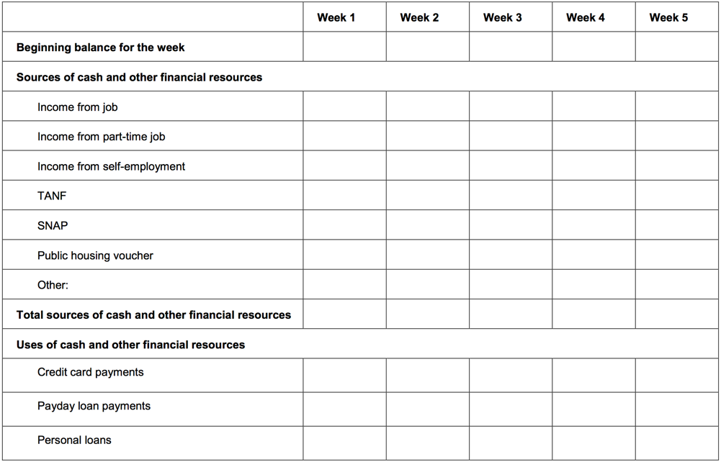
Tool 1: Cash Budget Flow Tracking

Slide 11
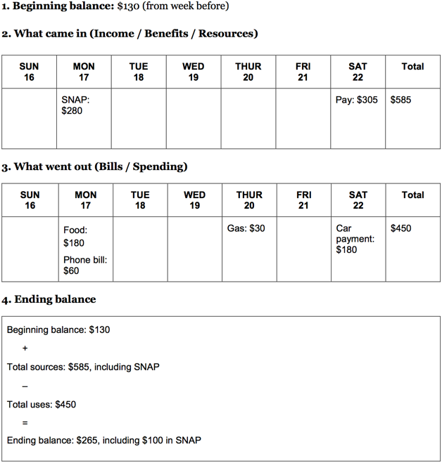
Tool 2: Cash Flow Calendar
Daily tracking helps visualize realities of daily spending and cost
Bill scheduling and planning
Total summing

Slide 12
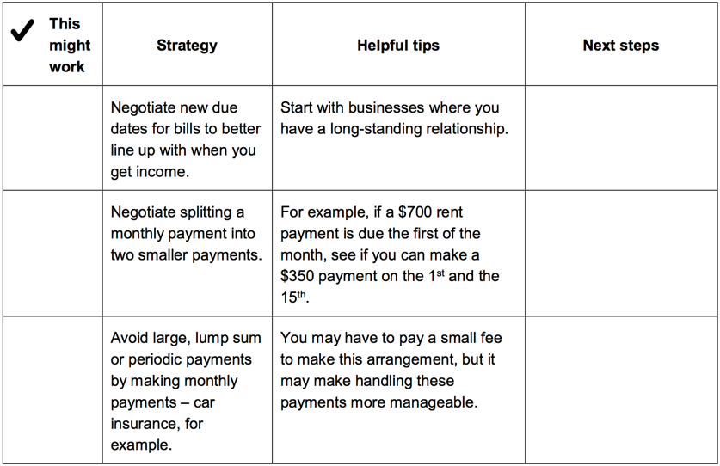
Tool 3: Improving Cash Flow
    Increase sources of cash, income, or other financial resources, including accessing public benefits and applying for tax credits for which you qualify.
    Decrease your spending or uses of cash and other financial resources.
    Match timing of sources and uses of income where possible.

Slide 13
Financial Planning Sessions with Clients
What can I work on with clients when I have …
Cash Flow Checklist
Cash Flow Budgeting & Calendar
Cash Flow Sustainability and Management
10
30
Multiple
Sessions
minutes
minutes

Slide 14

Module 6
6
Talking About and Managing Debts

Slide 15
What is Debt?
$
Money owed, often considered a liability and obligates future income. Debt is different from credit; credit is the potential to borrow money and often results in debt.
Discussing Debt
Debt is extremely personal. Some may not want to discuss debt, or may define it differently. Define debt with your client.

Slide 16
$
$
“GOOD” DEBT
- Long Term investments
- Low Interest Rates
- Credit Building
- Planned Debt
- Borrowing at similar return to wages (educational)
“BAD” DEBT
- Unnecessary Purchases*
- High Interest Rates
- Compounding Bad Credit
- Borrowing more than wage returns (educational debt)

Slide 17
$
$
“GOOD” DEBT
- Long Term investments
- Low Interest Rates
- Credit Building
- Planned Debt
- Borrowing at similar return to wages (educational)
“BAD” DEBT
- Unnecessary Purchases*
- High Interest Rates
- Compounding Bad Credit
- Borrowing more than wage returns (educational debt)
Remember!
Debt is extremely personal. Some may not want to discuss debt, or may define it differently. Debt conversations should involve:
Collaborated definition of debt
Unbiased and respectful communication
Trust building

Slide 18
Developing a Debt Management Worksheet
$
Write down a list of businesses, people, and credit lines/debts owed. Include amounts owed and timeline. Don’t forget to calculate interest rates.
Keep bills in one place
Maintain copies of your credit score

Slide 19
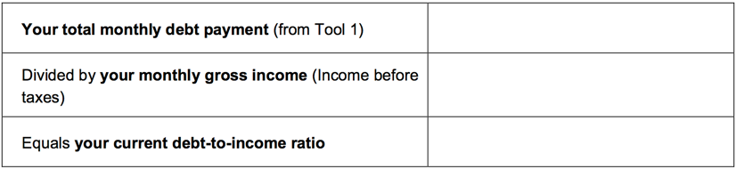
How Much Debt is Too Much Debt?
$
Debt to Income Ratio
The debt-to-income ratio is good measure of how much of your income is obligated to debt.

Slide 20
KNOW YOUR RIGHTS!
$
The Fair Debt Collection Practices Act protects consumers from harassment:
Repeated phone calls intended to annoy, abuse, or harass
Obscene or profane language
Threats of violence or harm
Publishing lists of people who refuse to pay their debts
Calling you without telling you who they are
Using false, deceptive, or misleading practices

Slide 21
Financial Planning Sessions with Clients
What can I work on with clients when I have …
Debt to Income Calculations
Building a Debt Worksheet
Dealing with Debt Collectors
Developing a Debt Reduction Worksheet
Discussing Student Loans
10
30
Multiple
Sessions
minutes
minutes

Slide 22
Module 9
9
Protecting Your Money

Slide 23
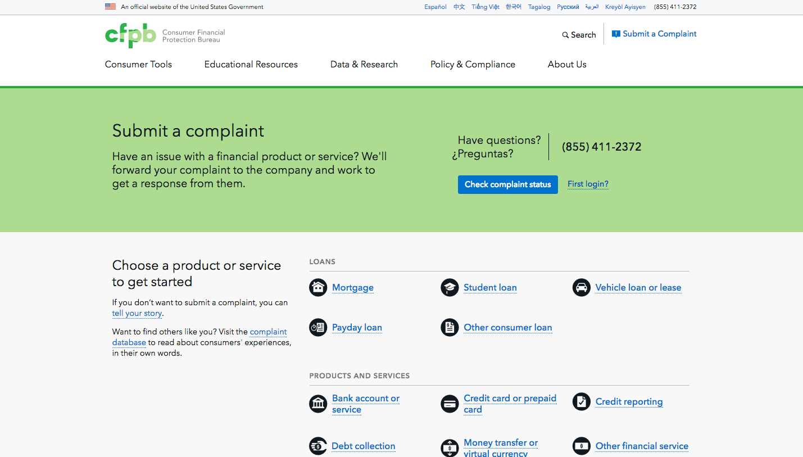
$
$
Financial Planning Sessions with Clients

Slide 24

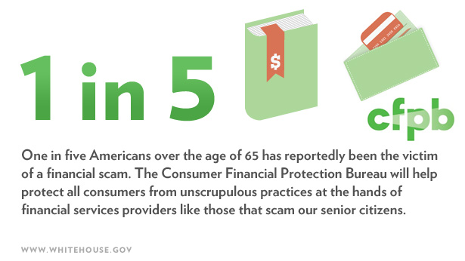
Protecting Yourself & Submitting a Complaint
  An empowered consumer understands their rights. When you know you have rights, you can take steps to protect yourself. The Bureau has already handled over 1,000,000 of consumer complaints.
  Every complaint the Bureau receives gives them insights into problems that people are experiencing in the marketplace and helps them to identify and prioritize problems for potential action.
  You can submit a complaint on behalf of someone else following the directions on the site.

Slide 25
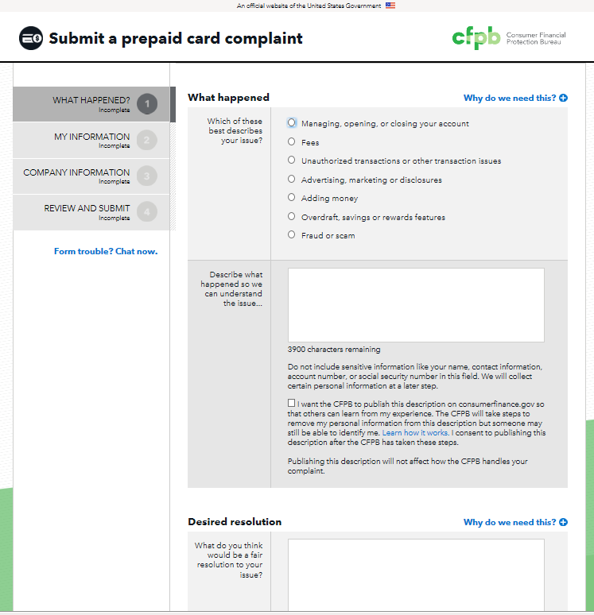
$
$

Slide 26
$
$
  Complaint submitted: You will receive email updates and can log in to track the status of your complaint.
  Review and route: The Bureau will forward your complaint and any documents you provide to the company and work to get a response from them. If they find that another government agency would be better able to assist, the Bureau will forward your complaint to them and let you know.
  Company response: After your complaint is sent to the company, the company has 15 days to provide a substantive response to you and the Bureau. In some cases, companies have up to 60 days to provide a final response.
  Complaint published: The Bureau publishes information about your complaint – such as the subject and date of the complaint – on their public Consumer Complaint Database at http://www.consumerfinance.gov/data-research/consumer-complaints/. With your consent they also publish your description of what happened, after taking steps to remove personal information.
  Consumer review: The Bureau will let you know when the company responds. You can review that response and give feedback.

Slide 27
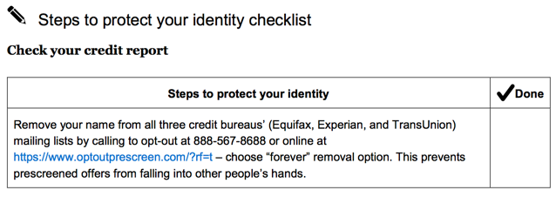
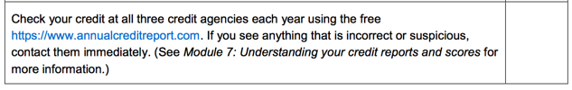
$
Protecting your identity
Identifying information is anything that is specifically unique to you, such as your:
Credit card and bank account numbers
Driver’s license number
Date, city, and state of birth
Social security number
Passwords or PIN numbers

Slide 28
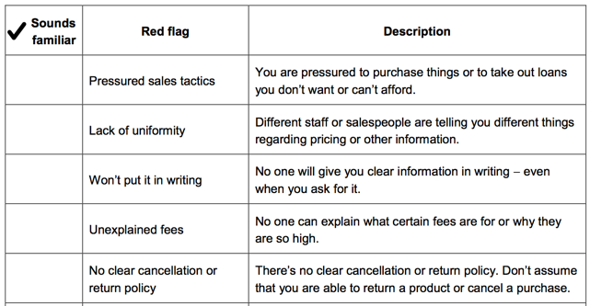
!!!!!
Protecting Your Assets and Recognizing Red Flags

Slide 29
Additional Resources
If you have a consumer complaint, visit: http://www.consumerfinance.gov/complaint/
For additional resources, visit the Bureau of Consumer Financial Protection website: http://www.consumerfinance.gov/
This toolkit also includes links or references to third-party resources or content that consumers may find helpful.
Links are organized by topics corresponding to the content modules
  Example: Understanding credit reports and scores:
    If you would like help managing your debt or rebuilding credit, visit the National Foundation for Credit Counseling:
    https://www.nfcc.org/

Slide 30
Thank You!
Next Week - Session 4: Disaster Recovery

