Slide 1
C-LEARN CEP Coalition Workgroup
Session 6 | September 19th

Slide 2
Today’s Agenda
Introductions – 5 minutes
Review of Session 5 – 5 minutes
Last Minute Planning – 50 minutes
Break!
Measuring Success – 25 minutes
Evaluations – 10 minutes

Slide 3
INTRODUCTIONS
5 minutes
Please state your name, organization, and one thing you’ve gained by participating in this coalition.

Slide 4
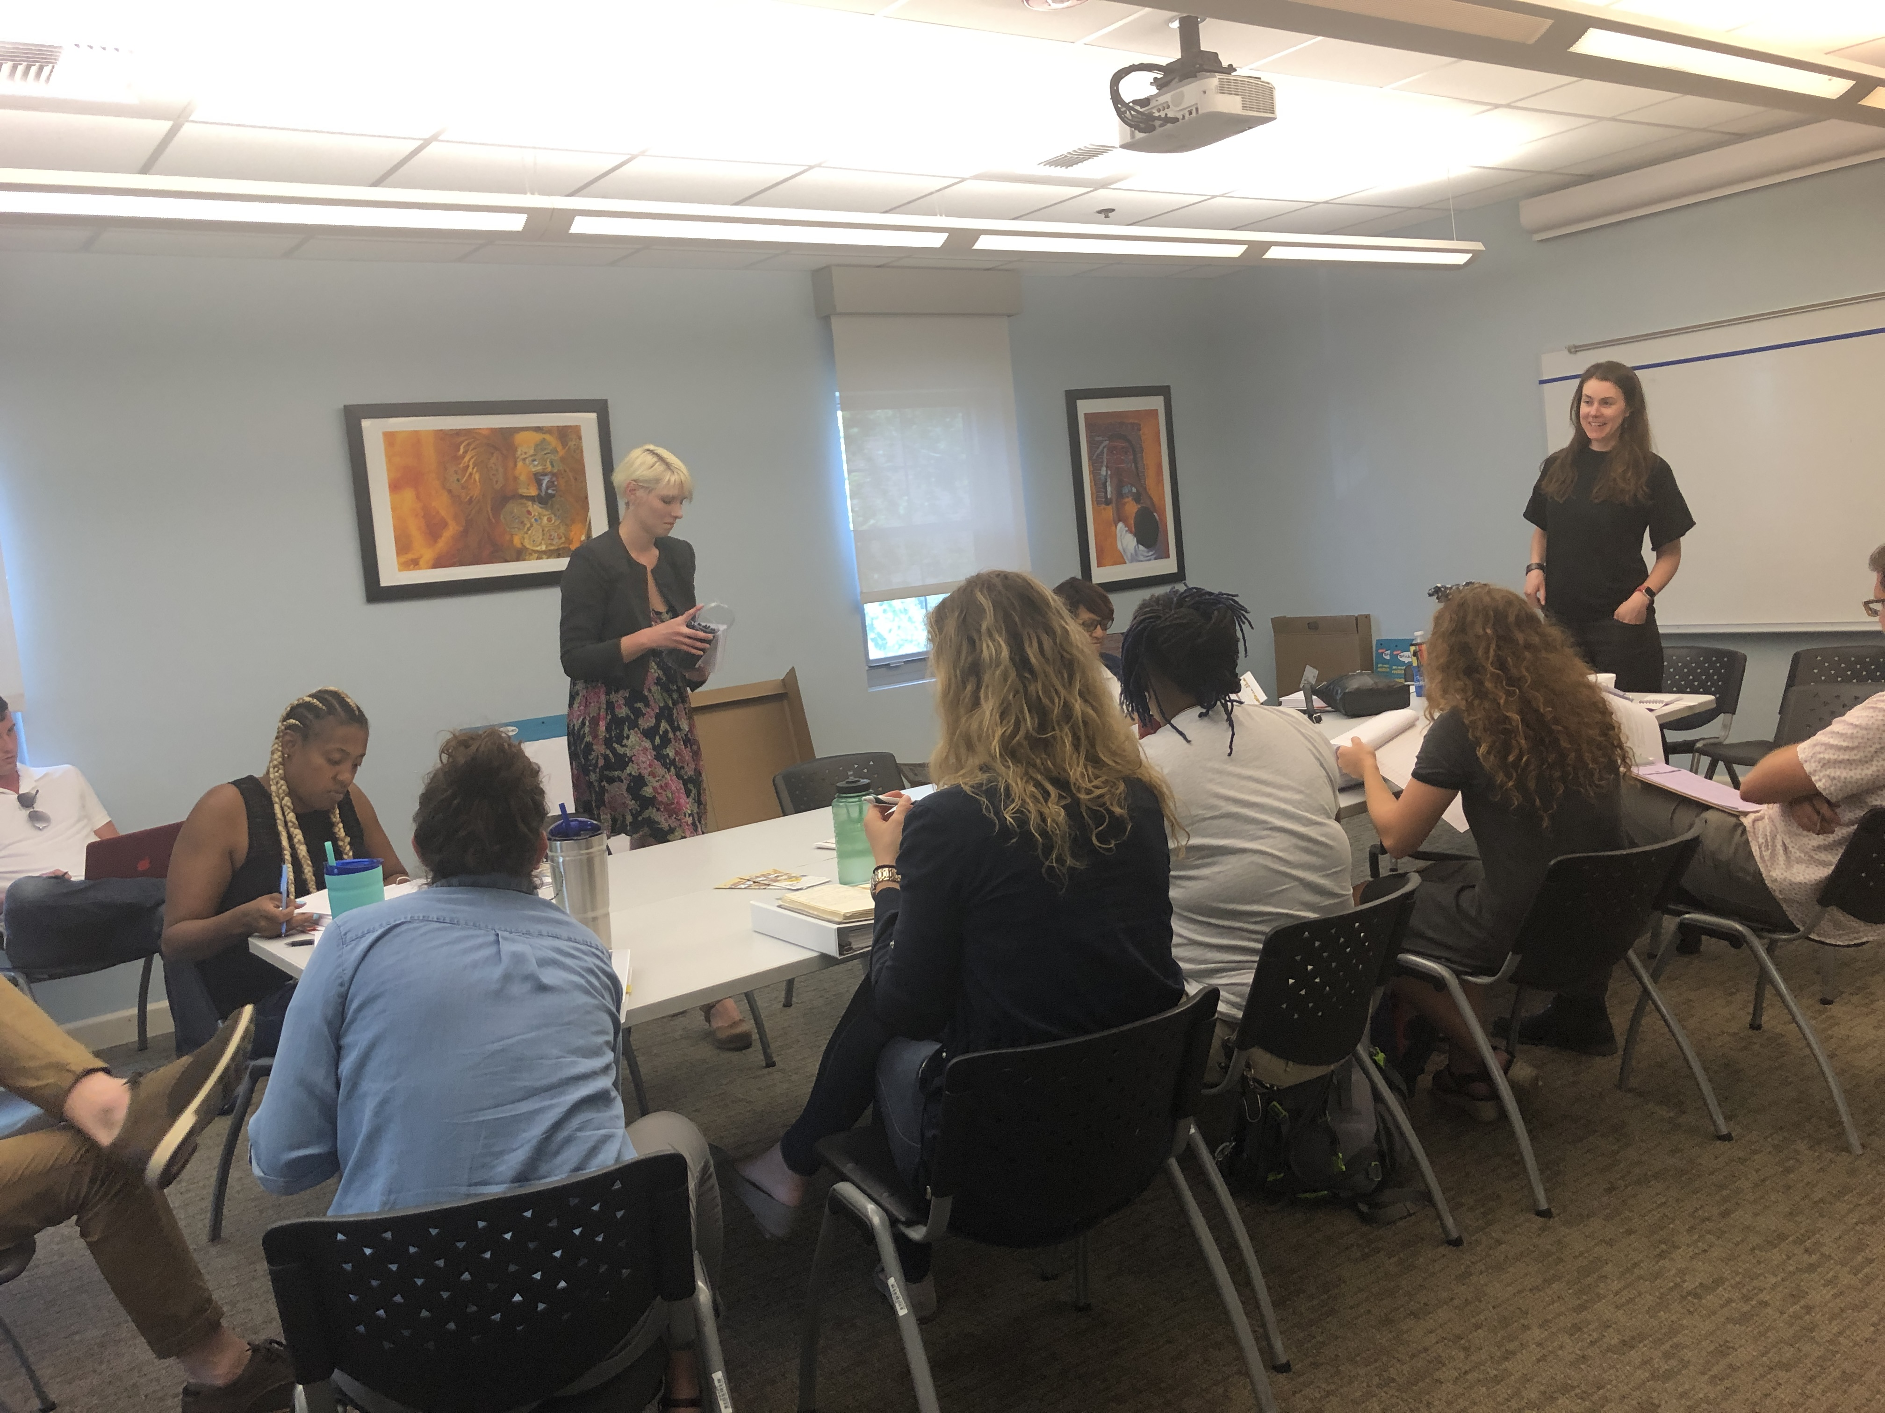
Session 5
5 minutes
The purpose of the last session was to work together in planning our Housing Fair to enhance resilience in New Orleans.

Slide 5
Our Final Event – Saturday, October 19th
11-11:30 (30 minutes): Tabling (All CEP Organization – Common Ground Health Clinic, NOAGE, Operation Restoration, Women with a Vision, LSU Health Network*, Habitat for Humanity, Bastion*, Evacuteer, HandsOn NOLA, A Community Voice, The Promise for Justice Initiative, Krewe de Lose)
11:30 -11:45 (15 minutes) – Welcome and Overview
11:45 – 12:30 (45 minutes)– Panel Discussion on Disaster/Financial/Mental Health/Re-Entry*
Disaster: HandsOn NOLA - Christopher Cameron
Financial: Empower Your Cents - Lori Jackson
Mental Health: Common Ground or Benjamin Springgate
Re-Entry: Operation Restoration - Dolfinette Martin*
12:30 – 12:45 (15 minutes) – Break

Slide 6
Our Final Event – Saturday, October 19th
12:45 -1:30 (45 minutes) – Concurrent Education Segment:
Renter’s Rights (GNOFAC/Tulane/Jane’s Place)
Access to Affordable Housing including Senior Housing, First Time Homebuying Program, other programs around banking and homeownership (Jericho Road, Habitat for Humanity, HANO)
Q&A from Audience
1:30 Giveaways
END

Slide 7
Our Final Event – Saturday, October 19th
Venue: Kingsley House or Rosenwald – in progress (Elizabeth)
Food – Big Poppa (Kenny Hall): (Veg) Red Bean/baked chicken/ jambalaya /green salad/peach cobbler/lemonade/water ($2500) (Thad)
Giveaways – Raffle: 2 - Bluetooth Speakers/Visa Gift Card $50 – 4 (all three at the end of the event) ($200) LSUHSC will handle
Music/AV – Poppa Smurf/Captain Charles (amount by the hour) – Pick on the 19th
Flyer – Ashley E & T (Free)
Decorations – Balloons, Tablecloths ($100)
Swag Items – drawstrings, chapstick, hand sanitizer, magnets, chip clips, pens, USB drives (Charles) ($5500)
Security ($250 - $300 for the entire event)
Kid activities – craft table, coloring sheets, markers, paint, crayons, playdoh, face painter ($500)

Slide 8
Last Minute Planning
45 minutes
Now, we are going to get into groups and plan out the details of our event. Within your groups, you are welcome assign tasks and deadlines to different people.
Group A: Logistics
Review Flyer
Secure venue
Volunteers to set up (come early) and clean up (stay later)
Order swag items*
Kiddie table attendant
Group B: Content Creators
Review Flyer
Determine opening speaker
Invite/confirm ALL presenters and panelists
Review questions for panel discussion
Create evaluations

Slide 9
BREAK TIME!
5 minutes

Slide 10
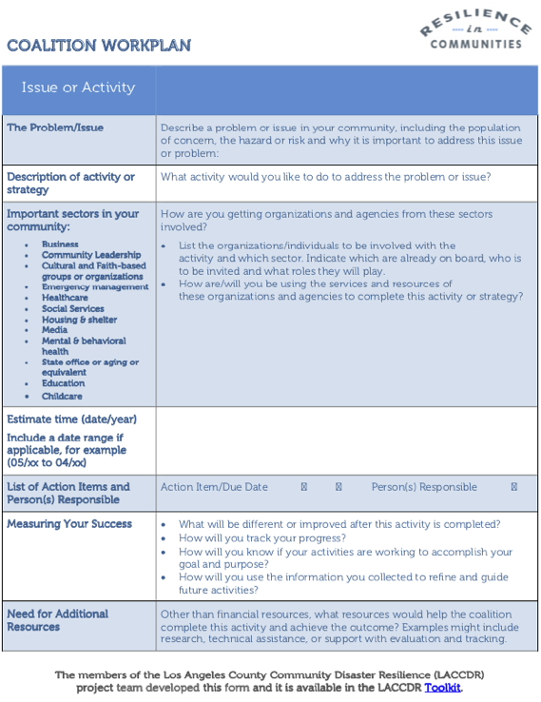
Measuring Our Success
10 minutes to reflect
15 minutes to share
What will be different or improved after this activity is completed?
How will you track your progress?
How will you know if your activities are working to accomplish your goal and purpose?
How will you use the information you collected to refine and guide future activities?
Page 30 in your CEP Workbook
Notes:
planning - drum up support in different areas, outreach into different areas, embodying the community conversations piece. Holding different times duting the week to discuss those topics then having the event.
Chanelling people into housing and accomodate people into housing
people knowing exaclty where to go and who to talk t about housing needs
discussion and case management, taking necesary step to reach their goals, follow up from evaluations.
How well the information was recieved and if they are asking questions
making good use of the evaluations
what follow up actions would you implement after attending the fair.
the colleective will give better resources (leveraging relationships from CEP) following up with what is given - referrals. moving outside of the mission to help people
Feedback on one section and tailoring it from there, referrals and connections

Slide 11
Thank You! & EVALUATIONS
10 minutes

